Slide 1


LinGrow User Manual
Multilingual Families Lab, U of Alberta

Slide 2


Basic Usage
Translation
Parent Self Signup
Child Signup
Login
Dashboard
Profile
Chat
Logout
Teacher Researcher Usage
Search User
Group Management
Admin Usage
Manage Schools
Manage Classrooms
Manage Users
Chapters

Slide 3


Basic Usage

Slide 4
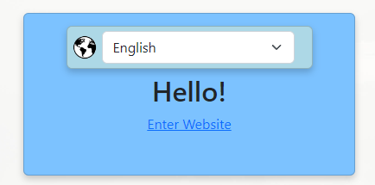
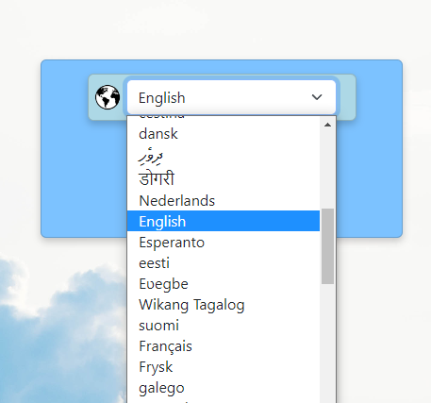
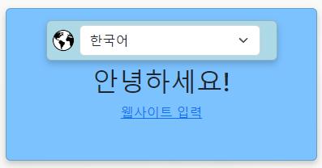
1.1 Website Translation
When you open the LinGrow WebApp for the first time you will be greeted by the Welcome Landing Page.
There Website translation is completed by clicking on the Language List element which creates a drop down menu, where you can select your language of choice.
After that all website elements will be translated into the selected language. Until you select a different language.
Welcome Page with Language List Button
Welcome Page translated into Korean
Language List Elements Dropdown Menu

Slide 5
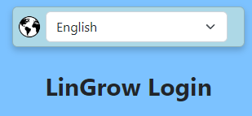
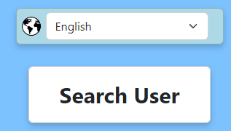
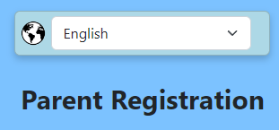
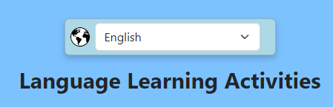
1.1 Website Translation
If you choose the wrong language by mistake, there can be found on virtually every page the same Language List button to change it to a language your recognize.
Language List on Login Page
Language List on Search User page
Language List on Parent Self Signup Page
Language button on Language Activities Page

Slide 6
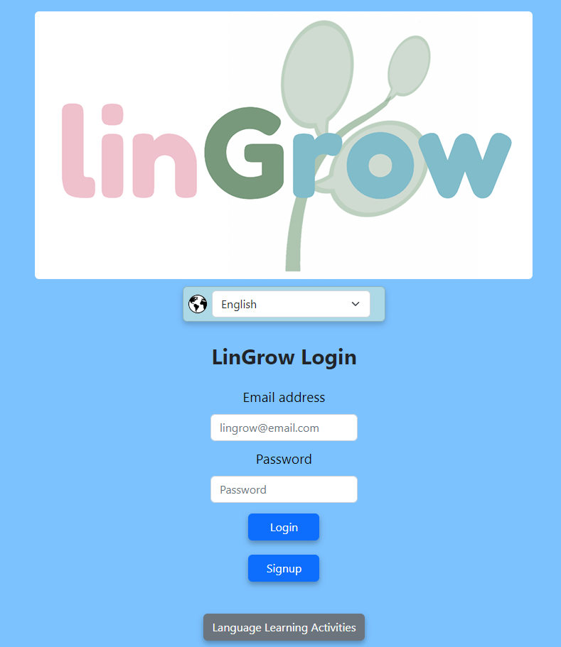
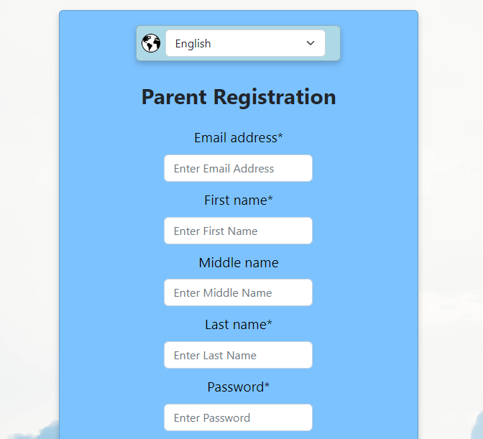
1.2 Parent Self-Signup
Once you have entered past the Welcome page you reach the login page. Here you can sign up to the LinGrow WebApp as a Parent.
To do so you click on the Signup button. This will redirect you to the Parent Registration Page. Where you type in the Email Address, Name, Password and your Child’s Name into the Website.
Parent Registration page
Signup Button pointed out on Login Page

Slide 7
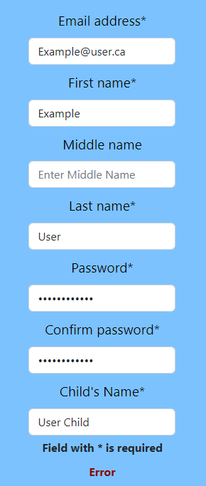
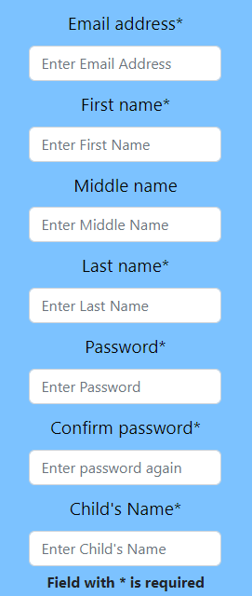
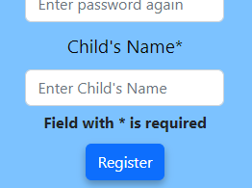

1.2 Parent Self-Signup
Empty Signup Page
Every Field with a Asterisk is a mandatory field and must be complete otherwise sign up will be unsuccessful.
Once you have Filled in every mandatory field you click the register button to be redirected back to the login page.
The parent’s password must be a String of 6 characters with at least one uppercase letter (ABC), one special character (@!*%), and one number (123).
You must also retype your password otherwise it will be rejected.
Filled Signup Page
Register Button on the signup page
Example Password with all requirements met
Signup page showing an error message

Slide 8
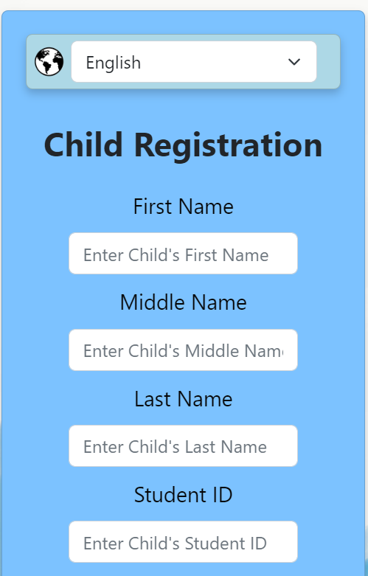
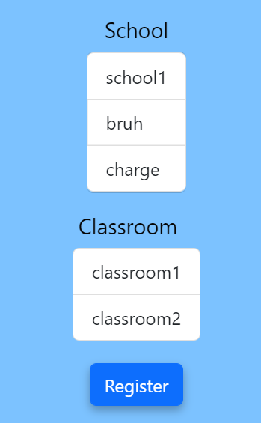
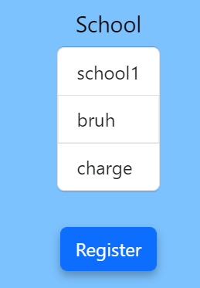
1.3 Child Signup
A button the parent can press in the dashboard is child signup, to sign up their children. It functions the same as the parent signup, except for their child.
They have the option to select their child’s school from a list of schools, and then their child’s classroom from a list of classrooms in said school.

Slide 9
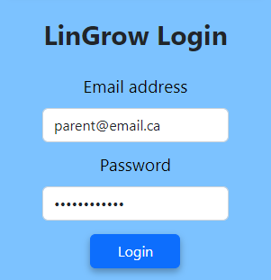
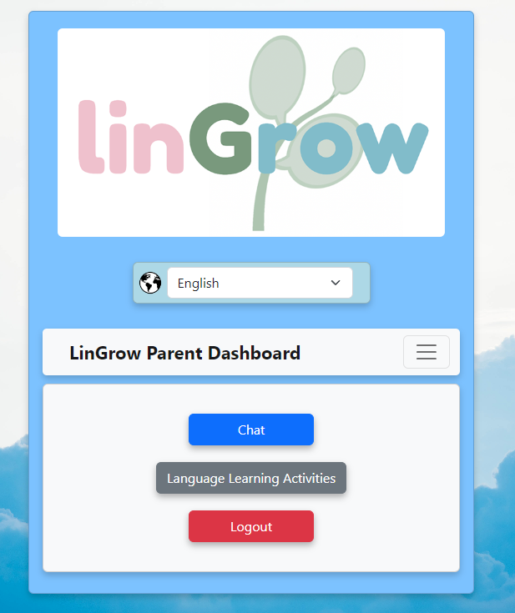
1.4 Login
To Login you must be on the login page of the website. Then you must enter in the Email Address you signed up to the website with followed by the Password you also used to signup. If you entered both correctly clicking on the Login button will take you to the dashboard corresponding to your user type.
If you fail to do this the fields will be reset and you will have to try again.
Filled Login fields
Parent User Type Dashboard

Slide 10
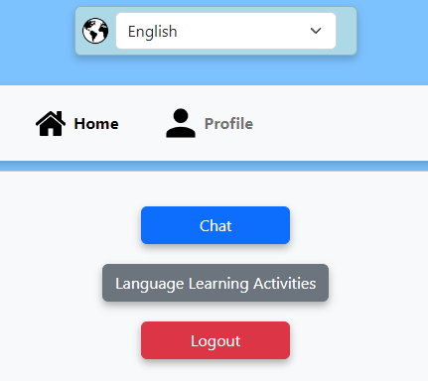

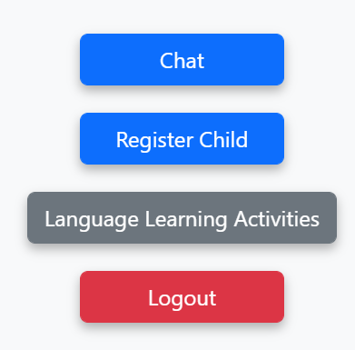

1.5 Dashboard Navigation
The Dashboard Navigation bar will always have the Home and Profile links, and and specialized features for the types of user logged in.
The Home and Profile buttons will be in a navigation bar above the other colored buttons on the main page.
The user specific features will be accessed via a list of buttons below the navigation bar.
The link will be inactive while on the main page but will redirect you to it when you are on any other page.
The link redirects you to the User Profile page, and will be inactive only on the User Profile page.
The user specific features will redirect you to a corresponding page, to help you accomplish that action.
Top arrow points to the Home and Profile buttons on a Parent Dashboard
Lower arrow points to the parent specific functions on a Parent Dashboard

Slide 11
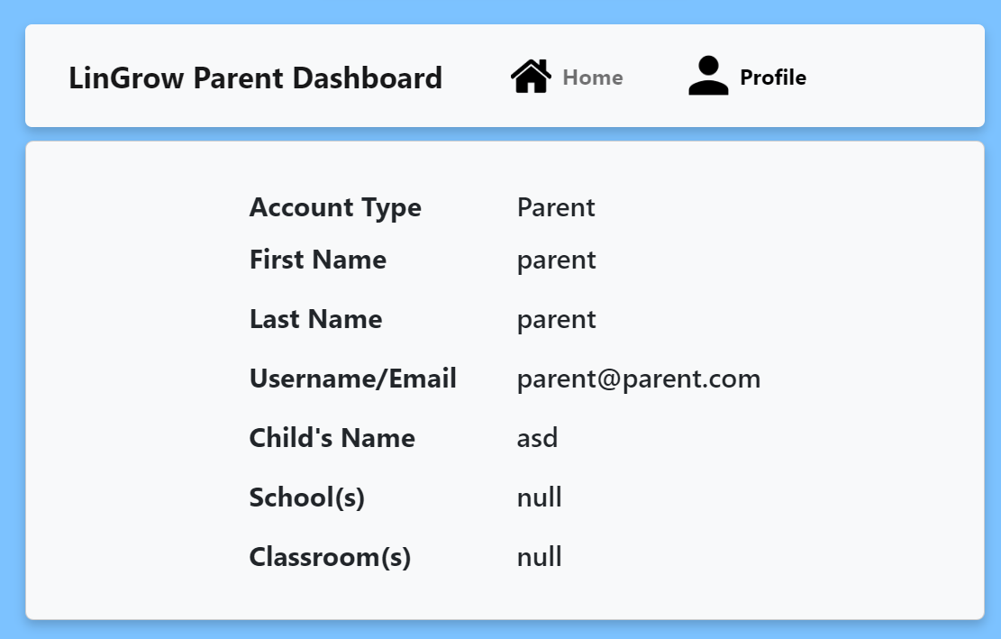
1.6 Profile Features
The User Profile page hosts all the information regarding a user, specific to that user.
It shows your Account Type, Name, and Email Address. Among other information specific to that user, such as Child’s Name, associated Teachers, and Schools for parents.
This information is not editable, as admins can change this information if required.
An example Parent Profile with their information displayed.

Slide 12
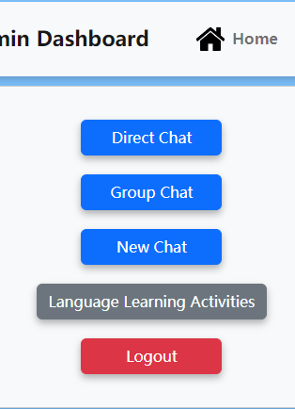
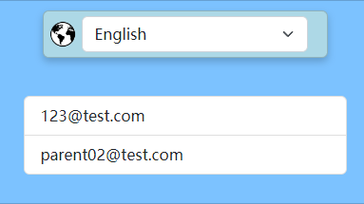
1.7 How To Use the Chat
To chat with someone, click Chat button in the dashboard.
For direct chat, you have to create a new chat by clicking New Chat and Select certain user you want to chat with by clicking them.
For group chat, you have to click the Group Chat button and select the group created.
After editing messages, click Send to let everyone in the group to see your message.
Next time when you want to chat with that user again, click direct chat to see the chat you created.

Slide 13
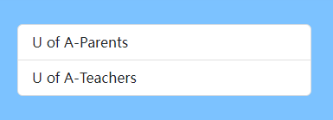
1.7 How To Use the Chat
This is how you enter the group chat:
Click group chat, then select the group you want to chat

Slide 14
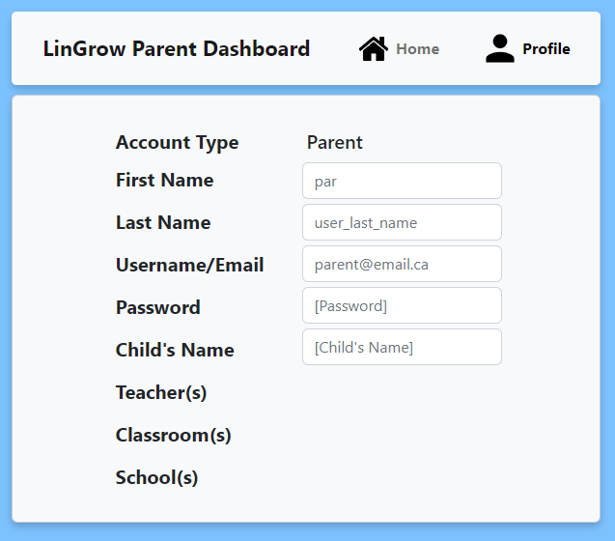
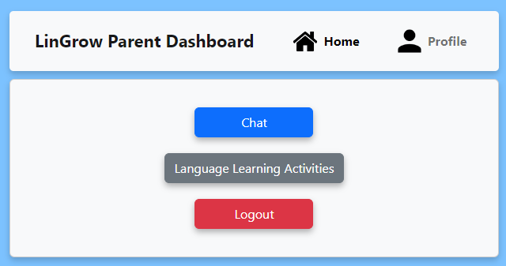
1.8 Logging Out of the Website
Logging out of the website is the easiest task but is only accessible when logged in from the Home Dashboard Page, As shown below. On other pages logout is not available.
User profile page with no logout button present
User Home Dashboard with Logout Button highlighted

Slide 15
2. Teacher Researcher Usage

Slide 16
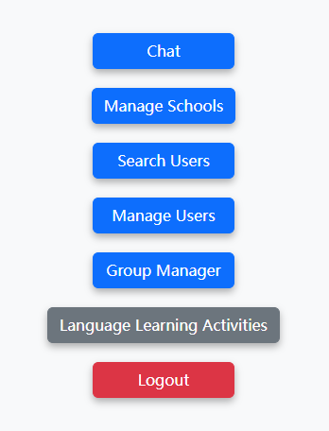
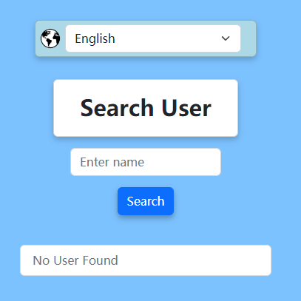
2.1 Searching for Users
(only for teachers, researchers and administrators)
To search users, you have to login as a teacher, researcher or admin.
Once you logged in as above user type, click
Search Users, and type the name (first or last name are fine) then click Search
An example admin dashboard

Slide 17
2.2 Group Management
(only for teachers, researchers and administrators)
To either create, delete groups, you have to login as a teacher, researcher or admin.
Once you logged in as above user type, click
Group Manager.
To check the group detail, click the group in the group list
To create a new group, click Create New Group, after filling in group name and id, selecting users you would like to invite, click Create group.
An example admin dashboard

Slide 18
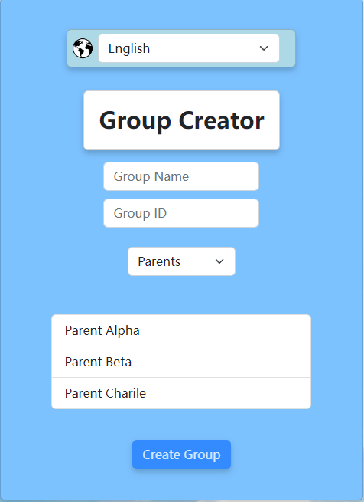
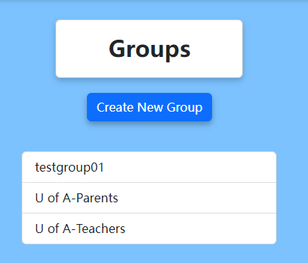
2.2 Group Management
(only for teachers, researchers and administrators)
This is how you create a new group:

Slide 19
3. Admin Usage

Slide 20
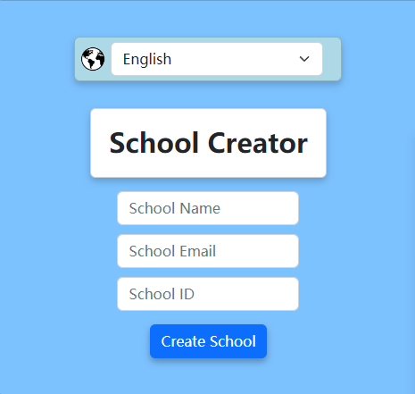
3.1 School Management
To create/delete a school or classroom, you have to login as an administrator.
Once you logged in as above user type, click
Manage Schools.
After filling up School Name, School Email (to identify school members) and School ID, click Create School to create a school.
An example admin dashboard

Slide 21
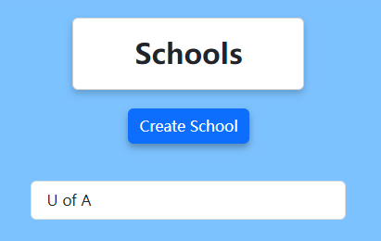
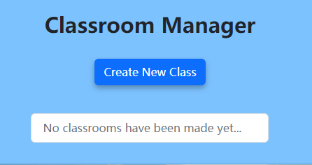
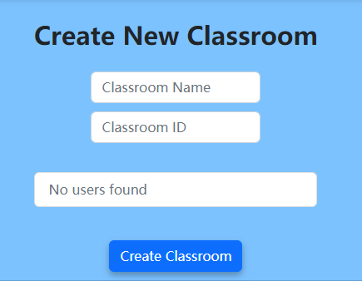
3.2 Classroom Management
To create/delete a classroom, click a school in the school list
Click Create New Class, after filling up the Classroom and Classroom ID, selecting users in user list you would like to invite, click Create Classroom.

Slide 22
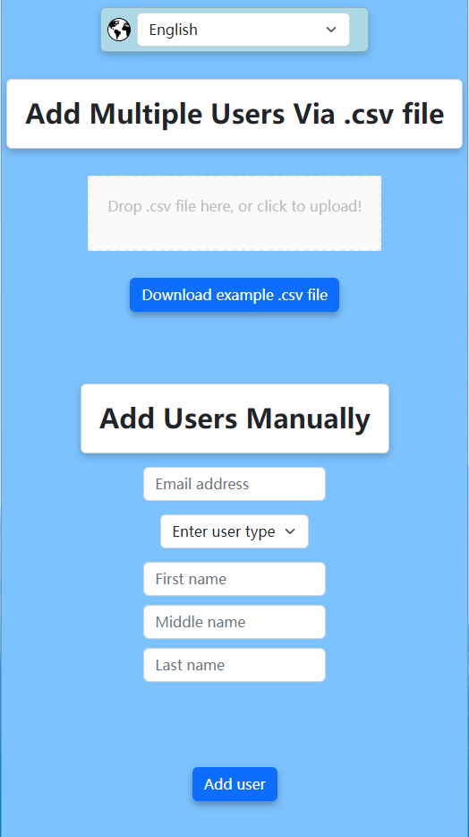
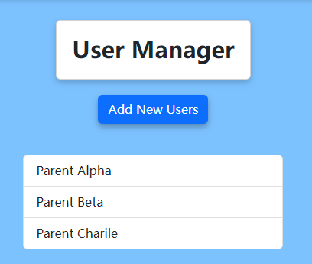
3.3 User Management
To add/delete a user, click Manage Users
Click Add New Users to add a new user
To add a teacher, you will need to select the
School and classroom for that teacher.
After filling up the Email Address, User Type,
Names, click Add users to finished creating.
You could also drop a .csv file in the dropbox with information of users you wanted to create. To see more information about a .csv file, click Download example .csv file

Slide 23
For Further Clarification reach out to the Developers of LinGrow, or the Multilingual Families Lab at the U of A
One of the primary features of the LinGrow Webapp is Ease of Use, so if anything is unclear reach out to us to give us feedback!

Slide 24
Copyright
www.ypppt.com
Notes:
模板来自于 http://www.ypppt.com

